Slide 1
Soil Respiration Estimation Research Proposal
By Vincent Lu

Slide 2
Validate
Train
Train Model
Hyperparameter Optimization
K-Fold Cross Validation, K=3
Train
Training Set
80%
Validate
Data
Train
Train
Validate
Testing Set
20%
Evaluate Model

Slide 3
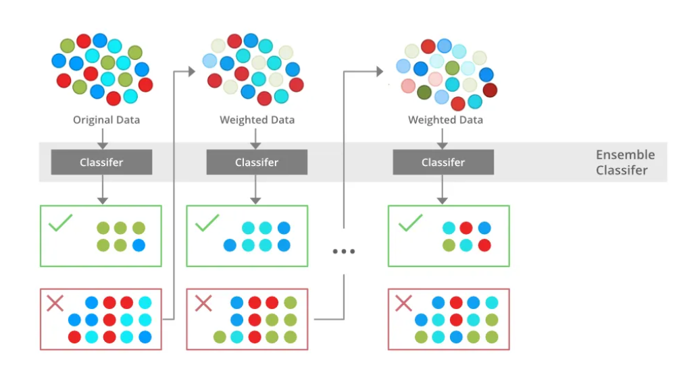
Figure 1: XGBoost model architecture

Slide 4
Table 1: Summary of feature names and variable types
Feature Category | Feature Names, variable type
Spatial/temporal | YearsOfData, Latitude, Longitude, Elevation, Biome
Climate (6) | MAT, MAP
Land use | Ecosystem_type, Ecosystem_state
Soil | Soil_type, Soil_drainage, Soil_BD, Soil_CN, Soil_sand, Soil_silt, Soil_clay
Carbon | BA, C_veg_total, C_AG, C_BG, C_CR, C_FR, C_litter, C_soilmineral, C_soildepth

Slide 5
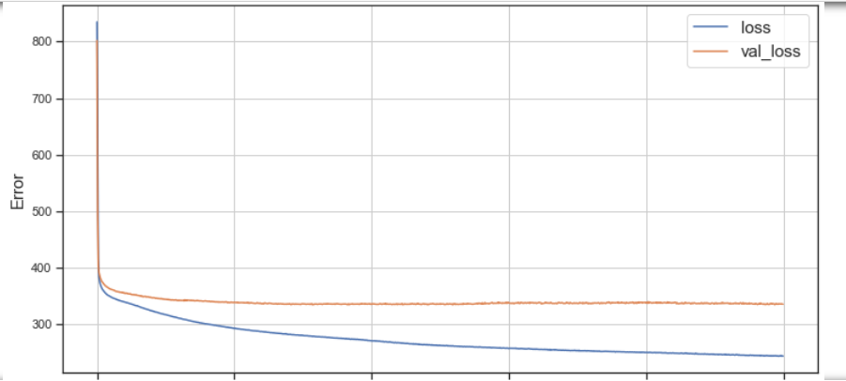
Figure 2: Diagram of feature importance B:Feature dispersion XGBoost Model

Slide 6
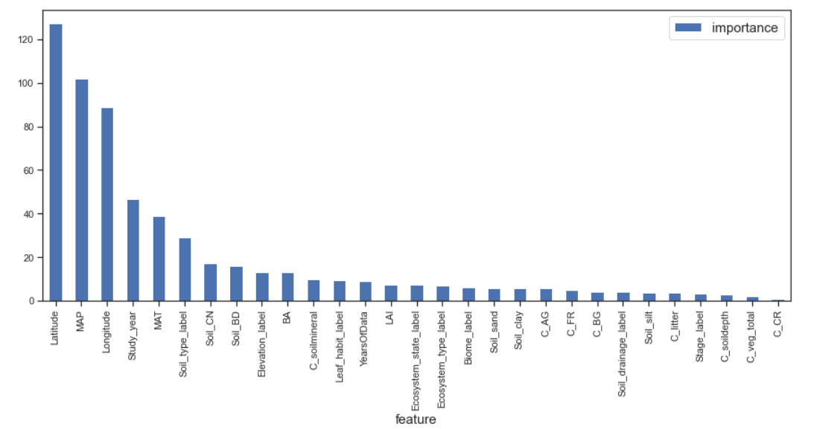
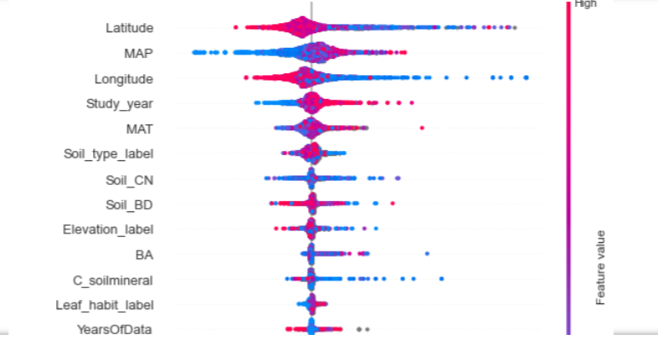
A
B
Figure 3: A) Diagram of feature importance; and B)Feature dispersion XGBoost Model

Slide 7
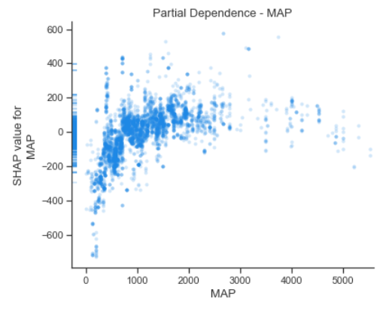
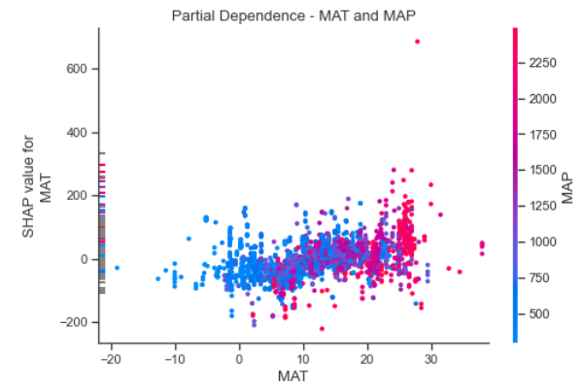
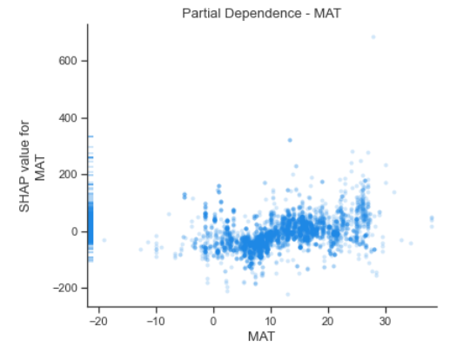
A
C
B
Figure 4: A) Partial dependence with respect to mean average precipitation; and B) with respect to mean average temperature; and C) how MAT and MAP interact with each other XGBoost Model

Slide 8
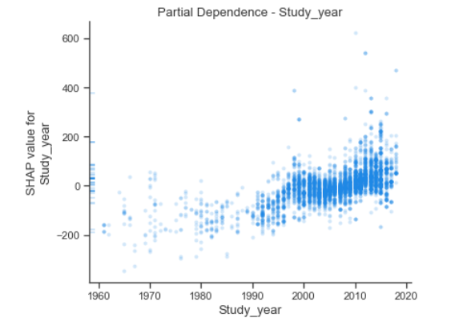
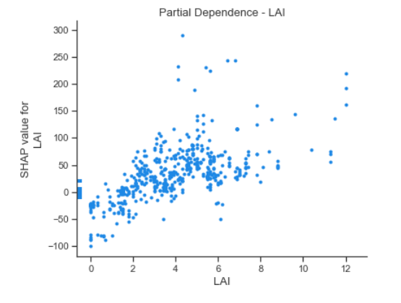
A
B
Figure 5: A) Partial dependence with the recorded CO2 emissions per study year; B) with respect to the Leaf Area Index; and C) XGBoost Model

Slide 9
Table 2: Summary of model performance and comparison
Evaluation metrics | Random Forest | Generic GB | XGBoost | DNN
MAE | 186.97 |  | 179.43 | 329.59
RMSE | 311.43 |  | 297.90 | 522.84
R^2 | 0.700 |  | 0.726 | 0.155
Remove the vertical lines

Slide 10
Table of contents
01
Introduction
02
Methodology
03
Results
04
Conclusion

Slide 11
Introduction
What is soil respiration?
Soil respiration is the process of soil releasing carbon dioxide into the atmosphere
The primary problem:
There are many factors that come into estimating soil respiration (Rs) leading some estimations becoming inaccurate
The emission of soil respiration is around 60 billion tons of carbon dioxide which is greater than the amount emitted by burning fossil fuels. The increase in temperatures increases the rate of soil respiration leading to greater and greater quantities of carbon dioxide being emitted and increasing global warming.

Slide 12
01
Introduction

Slide 13
Why is this research important and relevant?
Soil respiration is a significant contributor to global warming. Improving models will help to predicting and mitigate the impact of climate change.
Accurate estimates for soil respiration will help in maintaining ecosystems that are susceptible to climate change
Accurate data for soil respiration will help environmental policies aimed at reducing carbon emissions.

Slide 14
02
Methodology

Slide 15
Input Data
Soil respiration data: SRDB v5
Soil data: ERA5-Land (monthly), a product of the ERA5 climate reanalysis, which provides hourly data on many atmospheric, land-surface and sea-state parameters.
Climate data: ERA5 Monthly Aggregates
Land-use Data: SRDB v5
Vegetation data: USGS Landsat datasets

Slide 16
Data preparation
Clearing errors in the data and organizing it so that the model is efficient as possible (Data cleaning and normalization)
Filling missing data values with context clues
Removing inconsistencies from the data

Slide 17
Machine Learning Models
Inputs
Target Variable: Soil respiration
Independent Variables: 27 environmental factors, including geographical location, climate data, and ecological data.
Data set is split into 3 datasets
Training Set: 60% of the entire dataset is used for model training.
Validation set: 20% of the entire dataset is used for hyper-parameter tuning. This is especially important for DNN model
Testing Set: 20% of the entire dataset is used for out-of-sample evaluation.
Machine learning models
XGBoost Model
Deep Neural Network Model

Slide 18
03
Results

Slide 19
Performance evaluation:
Evaluate performance metrics (R², RMSE, MAE) of our models.
Compare these metrics from the two models and with those reported in previous studies.
Discuss the improvements and potential reasons for better performance.
Feature importance::
Identity top factors that impact soil respiration
What are the top factors in increasing soil respiration?
What are the top factors in decreasing soil respiration?

Slide 20
04
Conclusion

Slide 21
Based on the results, we can identify these key points
Are the two models in this study effective in predicting soil respiration based on environmental factors?
What are the keep drives that impact soil respiration?
What are the top factors in increasing soil respiration?
What are the top factors in decreasing soil respiration?
Identify key drivers that can be actioned upon.
Make recommendations to reduce soil respiration and slow down global warming.

Slide 22
References
Liu, J., Hu, J., Liu, H., et al. "Global Soil Respiration Estimation Based on Ecological Big Data and Machine Learning Model." Scientific Reports 14 (2024): 13231. https://doi.org/10.1038/s41598-024-64235-w.
Lu, H., S. Li, M. Ma, et al. 2021. "Comparing Machine Learning-Derived Global Estimates of Soil Respiration and Its Components with Those from Terrestrial Ecosystem Models." Environmental Research Letters 16, no. 5: Article 054048. https://doi.org/10.1088/1748-9326/abf526.

